Slide 1
Jolt Elevator Storyboard 1

Slide 2
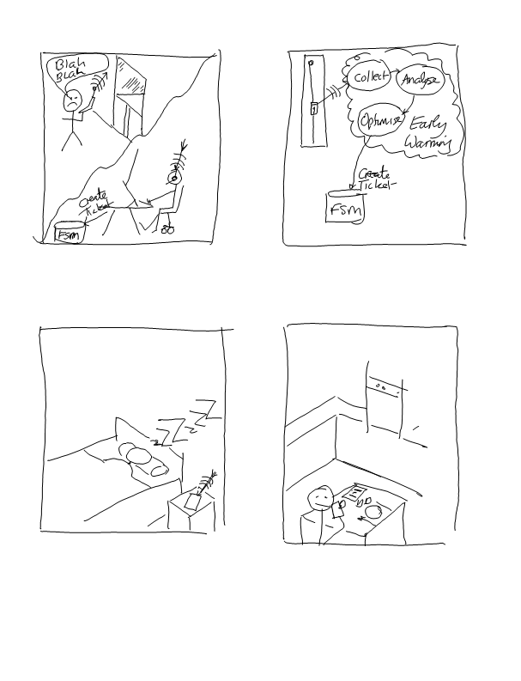
we start with a problem being reported
customer dials into the call center
agent tries to resolve the item over the phone, but reaches point where it needs an engineer to go onsite to take a look.
agent creates a new ticket ; gets assigned to Bob the technician
ticket might be generated by machine or by technician on-site
company policy dependant, of course …
(see separate storyboard)

Slide 3
As Bob sleeps that evening...
Information for tomorrows scheduled visits is downloaded
Ticket information
Pertinent service information for Customer A machine inventory
Bob reviews the schedule over breakfast
Confirms he has all the correct spares in the van
He reads up on a service bulletin about a dodgy part number used in a certain batch of door motors – we think/know customer A has one of these, so it might be useful to take a look whilst on site
Notes:
Critical point here is putting the RIGHT information in front of the user – contextually focused based on his tasks for the day e.g. make sure he has the right service information, warranty info, customer info. But also deliver relevant bulletins, software patches.
We might even be able to download the software directly, instead of sending engineer out! In the example above, information on the elevators with the dodgy door motor parts has already been downloaded onto the user machine – if the problem was urgent, we may have already created another ticket for him to replace it whilst on site.

Slide 4
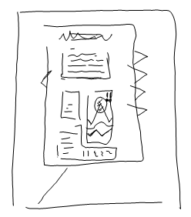
Bob can look at each ticket item in detail
current telemetry state
machine history
historical telemetry
plotted against other (similar) machines
Service history
What else has been done to this machine recently, by whom etc.
*this* ticket history
All presented in “glossy magazine” format
optionally download/cache other information he thinks could be useful
Notes:
Neil’s analogy : this is the doctor reading up on the patients notes before the patient comes into the surgery.

Slide 5
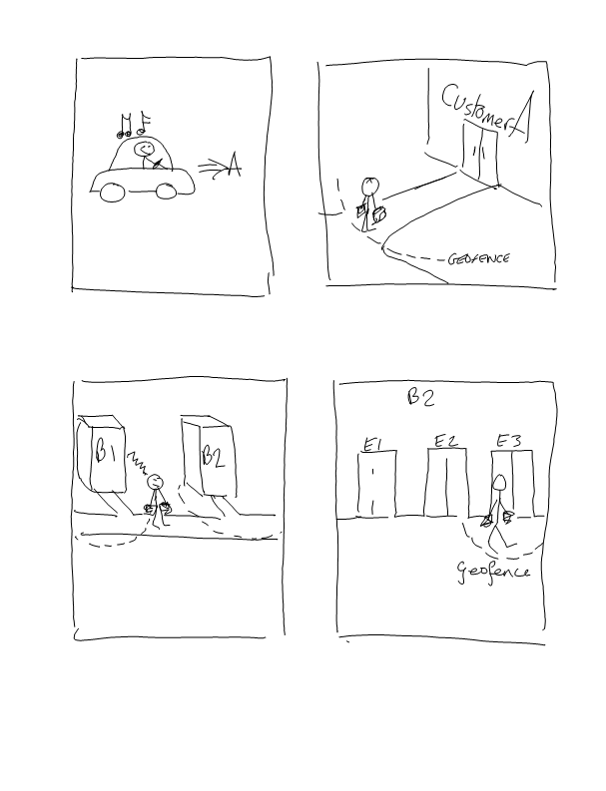
Bob hops in the car, and heads off to the first customer of the day
His phone/schedule punches the customer address into the satnav
Bob parks the car and heads into reception
He trips the geofence that has been setup for this customer location
Local notification sent to user – if he clicks ‘view’ he sees summary info for the active ticket(s) for this customer
contact name etc.
List of tickets
Machine identity
Relative location
Notes:
When he gets to customer, the background location tracking spots him tripping the outer geofence and sends local notification (i.e. “you have arrived” alarm call). If he clicks “view” the app will open on the “my tickets” page, filtered for this customer. There could be a number of tickets, and we are specifying which one he works on first – we just list the tickets in summary form i..e machine name/type and (perhaps) relative location

Slide 6
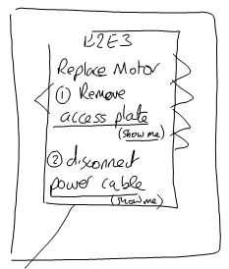
Bob gets to building 2 and walks up to elevator 3
He trips machine geofence, so ticket opens up listing what Bob needs to do
He’s back on the ticket detail page he was reading at breakfast this morning
Bob reads through the suggested fix
He sees the instruction mentions that he needs to remove an access plate
But where is the plate located?
He clicks “show me”…

Slide 7
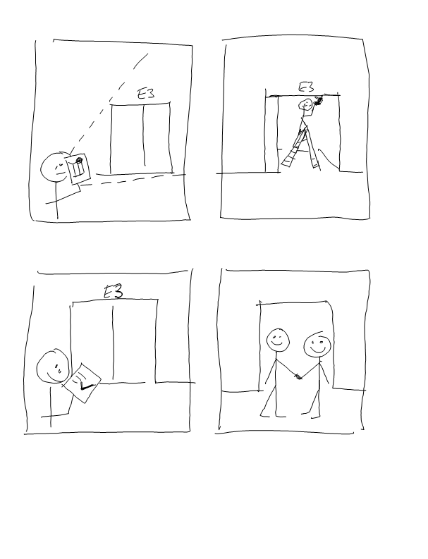
Bob switches to AR mode
The parts associated to the current issue are highlighted – Bob can see that the access plate is located above the doors
Bob opens the access plate and replaces the board
As each part is fitted, Bob scans them (like supermarket checkout - beep)
Information is registered against the AM BOM for this item
Notes:
Bob might be using some 3rd party work-order tool to drive the job/ticket and even to deliver the instructions. Jolt just needs some ‘key’ to the workorder so that it can get to it after the fact and extract the information for analysis. The idea behind the relay is that it could be steering the information to that 3rd party app, perhaps in realtime, but it might not be able to get to the results until the ticket is closed and user has left the site – at that point, we fetch the work order information from 3rd party system and digest it.

Slide 8
Having replaced the board, Bob runs some diagnostics and confirms the problem is fixed
Could be picking up local sensor data
He calls the customer contact who pops over and signs off the work.

Slide 9
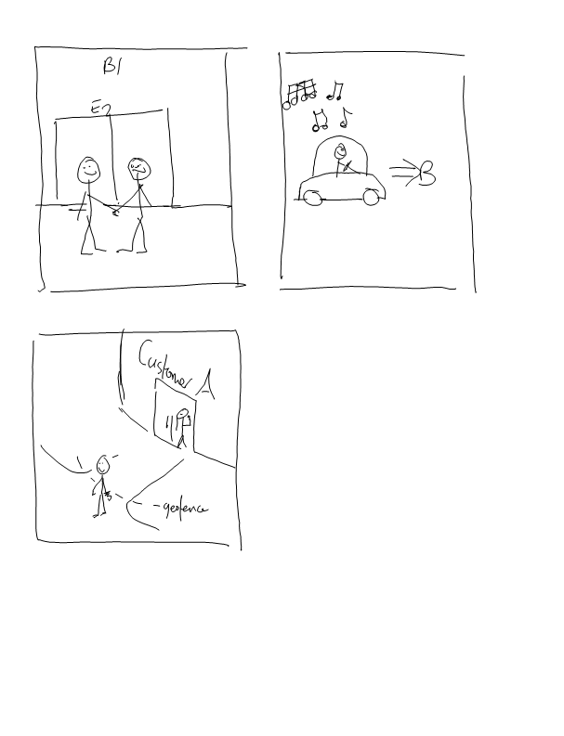
Bob heads back to the car
As he leaves, he trips the geofence
This closes the ticket?
Time on-site etc. is all logged
We might not upload this information until he gets home tonight…
Notes:
Does it close the ticket, or close this particular visit that is associated with the ticket?

Slide 10
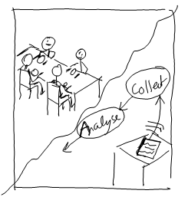
He jumps in the car and heads off to the next customer
Later that afternoon, Bob gets home. Whilst the family sits down for dinner, all the data from today is uploaded
Telemetry from the application, including service records, time logging, navigation trail and any internal application logging etc. all gets pushed back into the m2m store
Notes:
In this example, we restricted bulk data transfers (data download, evidence upload) to wi-fi i.e. when Bob is at home.
When out on the road, we haven’t discounted smaller messages that could happen over the phone network e.g. ticket creation.

